Slide 1
Computer Science has Changed

Slide 2
Hit a huge milestone…

Slide 3
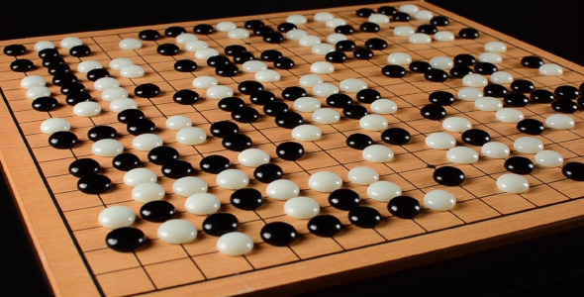

Slide 4
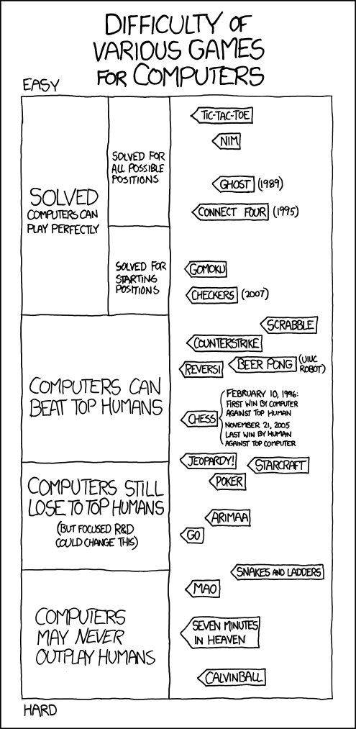

Slide 5
How they beat humans is meaningful

Slide 6
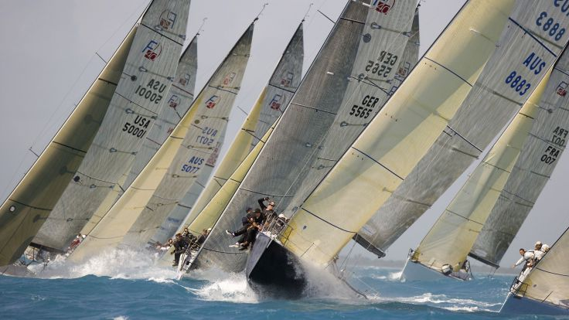

Slide 7
Partners after class

Slide 8

Today’s Goals
Understand Big O

Slide 9


Today’s Goals
Games
Exploration
Sorting
Big O
Searching
Big O River

Slide 10
Partners
What is Big O
Linear search
Binary search
Sorting
Travelling Salesperson
P vs NP
GO

Slide 11
An algorithm is O(g(n))
if the number of executions is <= M * g(n)
For some constant M.

Slide 12
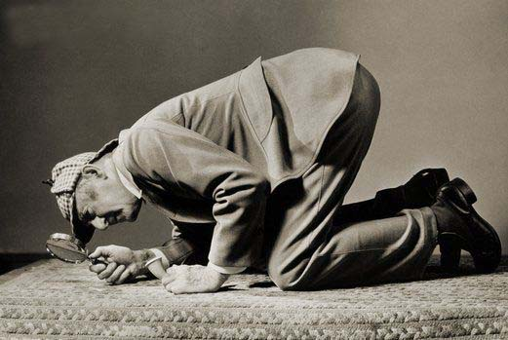
Searching

Slide 13
Linear Search
201
202
203
205
206
207
208
209
210
212
213
214
215
216
217
218
219
224
225
228
229
231
0
1
2
3
4
5
6
7
8
9
10
11
12
13
14
15
16
17
18
19
20
21
234
239
240
248
251
252
253
254
256
260
262
267
269
270
276
281
283
301
302
303
304
305
22
23
24
25
26
27
28
29
30
31
32
33
34
35
36
37
38
39
40
41
42
43
307
308
309
310
312
313
314
315
316
317
318
319
320
321
323
325
330
331
334
336
337
339
44
45
46
47
48
49
50
51
52
53
54
55
56
57
58
59
60
61
62
63
64
65
347
351
352
360
361
364
385
386
401
402
404
405
406
407
408
409
410
412
413
414
415
416
66
67
68
69
70
71
72
73
74
75
76
77
78
79
80
81
82
83
84
85
86
87
417
419
423
424
425
430
432
434
435
440
443
445
469
470
475
478
479
480
484
501
502
503
88
89
90
91
92
93
94
95
96
97
98
99
100
101
102
103
104
105
106
107
108
109
504
505
507
508
509
510
512
513
515
516
517
518
520
530
540
541
551
559
561
562
563
564
110
111
112
113
114
115
116
117
118
119
120
121
122
123
124
125
126
127
128
129
130
131
567
570
571
573
574
575
580
585
586
601
602
603
605
606
607
608
609
610
612
614
615
616
132
133
134
135
136
137
138
139
140
141
142
143
144
145
146
147
148
149
150
151
152
153
617
618
619
620
623
626
630
631
636
641
646
650
651
660
661
662
678
682
701
702
703
704
154
155
156
157
158
159
160
161
162
163
164
165
166
167
168
169
170
171
172
173
174
175
706
707
708
712
713
714
715
716
717
718
719
720
724
727
731
732
734
740
754
757
760
762
176
177
178
179
180
181
182
183
184
185
186
187
188
189
190
191
192
193
194
195
196
197
763
765
769
770
772
773
774
775
779
781
785
786
801
802
803
804
805
806
808
810
812
813
198
199
200
201
202
203
204
205
206
207
208
209
210
211
212
213
214
215
216
217
218
219
814
815
816
817
818
828
830
831
832
835
843
845
847
848
850
856
857
858
859
860
862
863
220
221
222
223
224
225
226
227
228
229
230
231
232
233
234
235
236
237
238
239
240
241
864
865
870
878
901
903
904
906
907
908
909
910
912
913
914
915
916
917
918
919
920
925
242
243
244
245
246
247
248
249
250
251
252
253
254
255
256
257
258
259
260
261
262
263
928
931
936
937
940
941
947
949
951
952
954
956
959
970
971
972
973
978
979
980
985
989
264
265
266
267
268
269
270
271
272
273
274
275
276
277
278
279
280
281
282
283
284
285

Slide 14
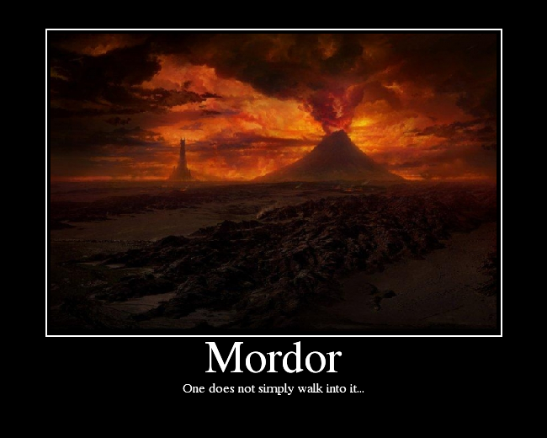

Slide 15
Binary Search
143 + 177
143 + 213
161 + 168
161 + 177
143 + 285
165 + 165
0 + 285
165 + 168
, which is the 650 at index 165:
Continue with element
, which is the 630 at index 160:
Continue with element
, which is the 708 at index 178:
Continue with element
, which is the 646 at index 164:
Continue with element
, which is the 662 at index 169:
Continue with element
, which is the 805 at index 214:
The key 650 is greater than 602, so discard the first half.
The key 650 is less than 805, so discard the second half.
The key 650 is less than 708, so discard the second half.
The key 650 is greater than 630, so discard the first half.
The key 650 is less than 662, so discard the second half.
The key 650 is greater than 646, so discard the first half.
The key 650 is less than 651, so discard the second half.
The key 650 is equal to 650, so the process is finished.
Binary search needs to look at only eight elements to find 650.
Continue with element
Start with the element at index
, which is the 602 at index 142:
Continue with element
, which is the 651 at index 166:
2
2
2
2
2
2
2
2
201
202
203
205
206
207
208
209
210
212
213
214
215
216
217
218
219
224
225
228
229
231
0
1
2
3
4
5
6
7
8
9
10
11
12
13
14
15
16
17
18
19
20
21
234
239
240
248
251
252
253
254
256
260
262
267
269
270
276
281
283
301
302
303
304
305
22
23
24
25
26
27
28
29
30
31
32
33
34
35
36
37
38
39
40
41
42
43
307
308
309
310
312
313
314
315
316
317
318
319
320
321
323
325
330
331
334
336
337
339
44
45
46
47
48
49
50
51
52
53
54
55
56
57
58
59
60
61
62
63
64
65
347
351
352
360
361
364
385
386
401
402
404
405
406
407
408
409
410
412
413
414
415
416
66
67
68
69
70
71
72
73
74
75
76
77
78
79
80
81
82
83
84
85
86
87
417
419
423
424
425
430
432
434
435
440
443
445
469
470
475
478
479
480
484
501
502
503
88
89
90
91
92
93
94
95
96
97
98
99
100
101
102
103
104
105
106
107
108
109
504
505
507
508
509
510
512
513
515
516
517
518
520
530
540
541
551
559
561
562
563
564
110
111
112
113
114
115
116
117
118
119
120
121
122
123
124
125
126
127
128
129
130
131
567
570
571
573
574
575
580
585
586
601
602
603
605
606
607
608
609
610
612
614
615
616
132
133
134
135
136
137
138
139
140
141
142
143
144
145
146
147
148
149
150
151
152
153
617
618
619
620
623
626
630
631
636
641
646
650
651
660
661
662
678
682
701
702
703
704
154
155
156
157
158
159
160
161
162
163
164
165
166
167
168
169
170
171
172
173
174
175
706
707
708
712
713
714
715
716
717
718
719
720
724
727
731
732
734
740
754
757
760
762
176
177
178
179
180
181
182
183
184
185
186
187
188
189
190
191
192
193
194
195
196
197
763
765
769
770
772
773
774
775
779
781
785
786
801
802
803
804
805
806
808
810
812
813
198
199
200
201
202
203
204
205
206
207
208
209
210
211
212
213
214
215
216
217
218
219
814
815
816
817
818
828
830
831
832
835
843
845
847
848
850
856
857
858
859
860
862
863
220
221
222
223
224
225
226
227
228
229
230
231
232
233
234
235
236
237
238
239
240
241
864
865
870
878
901
903
904
906
907
908
909
910
912
913
914
915
916
917
918
919
920
925
242
243
244
245
246
247
248
249
250
251
252
253
254
255
256
257
258
259
260
261
262
263
928
931
936
937
940
941
947
949
951
952
954
956
959
970
971
972
973
978
979
980
985
989
264
265
266
267
268
269
270
271
272
273
274
275
276
277
278
279
280
281
282
283
284
285

Slide 16


Slide 17
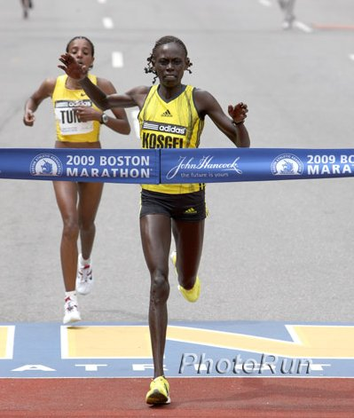
How Can We Compare

Slide 18
Today’s Goals
Games
Exploration
Sorting
Big O
Searching
Big O River

Slide 19
Today’s Goals
Games
Exploration
Sorting
Big O
Searching
Big O River

Slide 20
Timing?
In C++, you can measure elapsed time by calling the time function
The time function is often too rough.
Some measurements are likely to be wildly off.
Different computers.
Different translation of code.

Slide 21
Big O
Upper bound on number of operations
We say a function f(n) is “big-O” of another function g(n), and write “f(n) is O(g(n))” if there exist positive constants c and n₀ such that:
f(n) ≤ c g(n) for all n ≥ n₀.
Worst case scenario

Slide 22
Big O of Binary Search?

Slide 23
Comparing Big O
Number of steps required for linear vs. binary search:
linear
N
binary
log N
10
3
100
7
1000
10
1,000,000
20
1,000,000,000,000,000
60

Slide 24
Today’s Goals
Games
Exploration
Sorting
Big O
Searching
Big O River

Slide 25
Today’s Goals
Games
Exploration
Sorting
Big O
Searching
Big O River

Slide 26
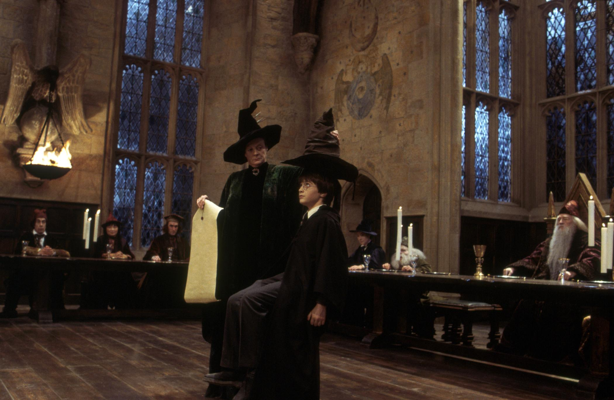
Sorting

Slide 27
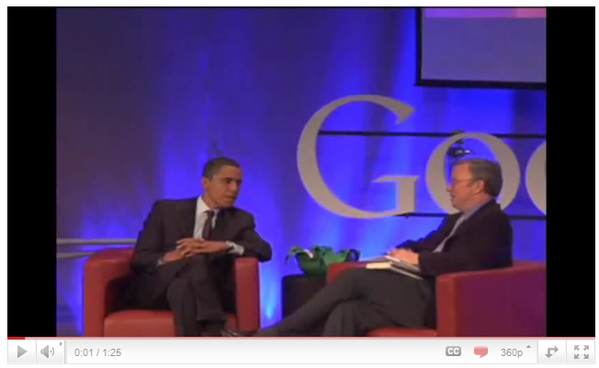
Even Presidents Have to Know
http://www.youtube.com/watch?v=k4RRi_ntQc8

Slide 28



Selection Sort
int main() {
Vector<int> vec = CreateTestVector();
Sort(vec);
return 0;
}
int main() {
Vector<int> vec = CreateTestVector();
Sort(vec);
return 0;
}
void Sort(Vector<int> & vec) {
for ( int lh = 0 ; lh < vec.size() ; lh++ ) {
int rh = FindSmallest(vec, lh, vec.size() - 1);
Swap(vec[lh], vec[rh]);
}
}
void Sort(Vector<int> & vec) {
for ( int lh = 0 ; lh < vec.size() ; lh++ ) {
int rh = FindSmallest(vec, lh, vec.size() - 1);
Swap(vec[lh], vec[rh]);
}
}
int FindSmallest(Vector<int> & vec, int p1, int p2) {
int smallestIndex = p1;
for ( int i = p1 + 1 ; i <= p2 ; i++ ) {
if (vec[i] < vec[smallestIndex]) smallestIndex = i;
}
return smallestIndex;
}
vec
vec
lh
rh
vec
lh
rh
vec
3
6
7
8
0
9
1
2
3
4
5
6
7
8
9
10
smallestIndex
i
p1
p2
vec
1
0
9
2
3
4
5
6
7
8
9
0
10
1
3
6
7
809
503
946
367
987
838
259
236
659
361
809
503
946
367
987
838
259
236
659
361
0
1
2
3
4
5
6
7
8
9
0
1
2
3
4
5
6
7
8
9
skip simulation

Slide 29
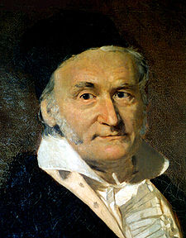
Gauss Summation

Slide 30
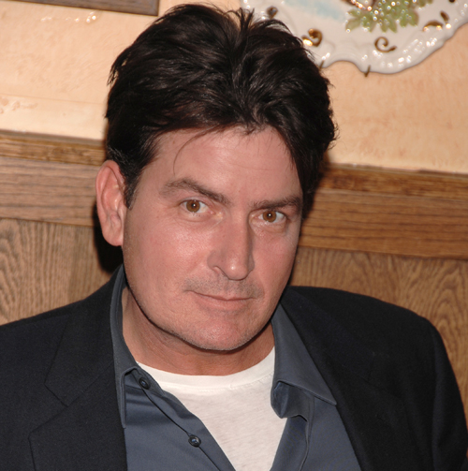
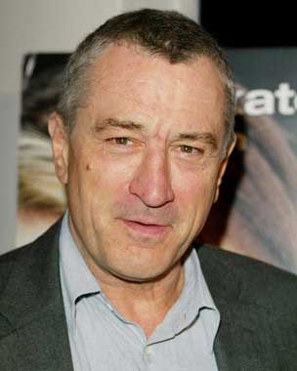
Gauss Summation

Slide 31
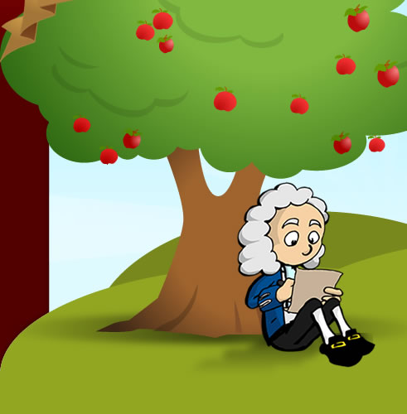

Slide 32
Selection Sort Complexity

Slide 33
Merge Sort
1.
Divide the vector into two halves: v1 and v2.
2.
Sort each of v1 and v2 recursively.
3.
Clear the original vector.
4
Merge elements into the original vector by choosing the smallest element from v1 or v2 on each cycle.
vec
809
503
946
367
987
838
259
236
659
361
236
259
361
367
503
659
809
838
946
987
809
503
946
367
987
838
259
236
659
361
0
1
2
3
4
5
6
7
8
9
0
1
2
3
4
5
6
7
8
9
v1
809
503
946
367
987
367
503
809
946
987
0
1
2
3
4
v2
838
236
259
259
236
361
659
659
361
838
0
1
2
3
4
Notes:
33

Slide 34
Merge Sort Complexity
Sorting 8 items
requires
Two sorts of 4 items
which requires
Four sorts of 2 items
which requires
Eight sorts of 1 item
The work done at each level (i.e., the sum of the work done by all the calls at that level) is proportional to the size of the vector. The running time is therefore proportional to N times the number of levels.

Slide 35
Merge Sort Complexity

Slide 36
Comparing Sort
The difference between O(N ²) and O(N log N) is enormous for large values of N, as shown in this table:
N
N ²
N log₂ N
10
100
30
100
10,000
700
1,000
1,000,000
10,000
10,000
100,000,000
100,000
100,000
10,000,000,000
2,000,000
1,000,000
1,000,000,000,000
20,000,000

Slide 37
Socrative
a) O(1)
b) O(logN)
c) O(N)
d) O(N²)
for (int k = n; k >= 0; k--) {
cout << k << endl;
}
O (N )
This loop executes n times.
for (int i = 0; i < n; i++) {
for (int j = 0; j < i; j++) {
cout << j << endl;
}
}
O ( N ² )
This loop follows the pattern from selection sort.
for (int i = 0; i < 100; i++) {
for (int j = 0; j < i; j++) {
cout << j << endl;
}
}
O ( 1)
This loop does not depend on the value of n at all.

Slide 38
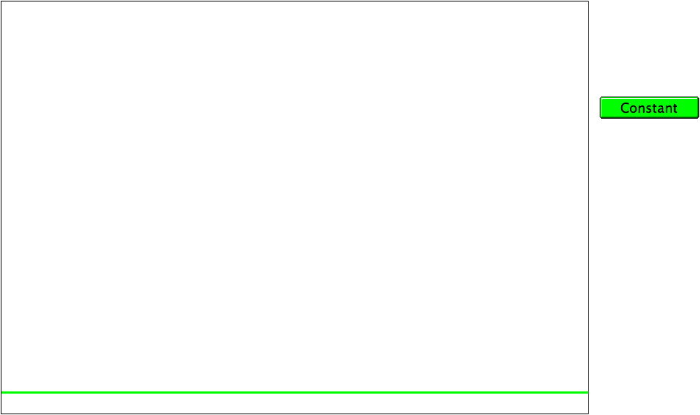
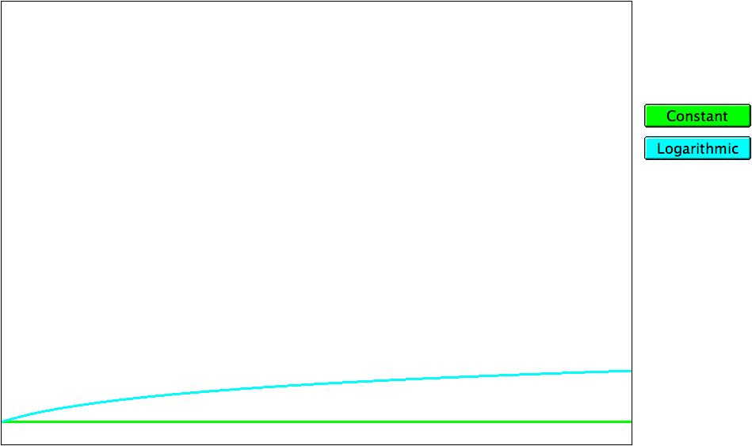
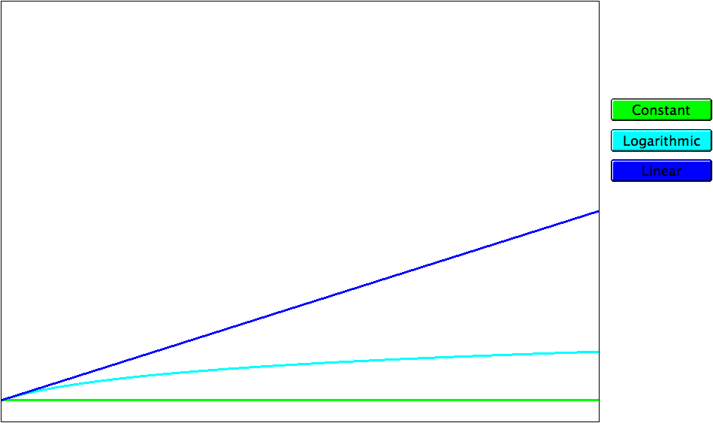
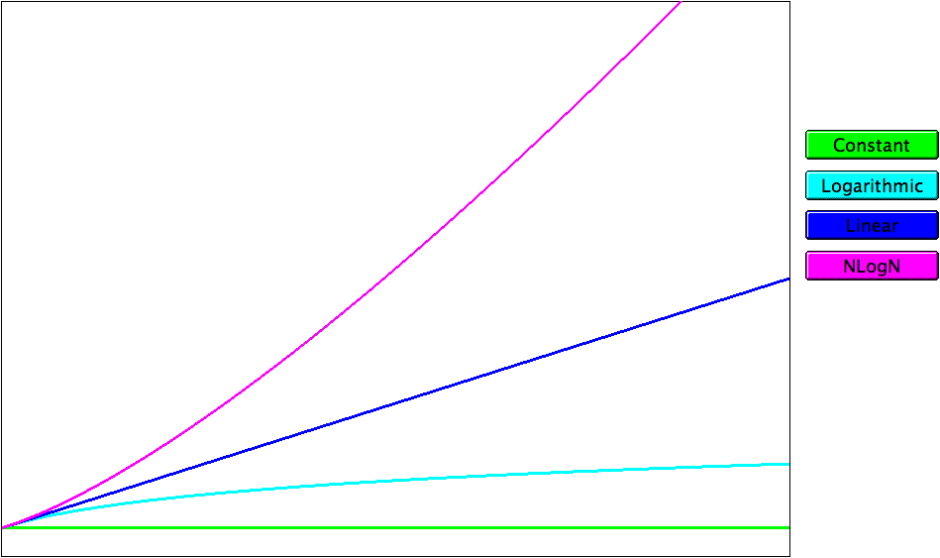
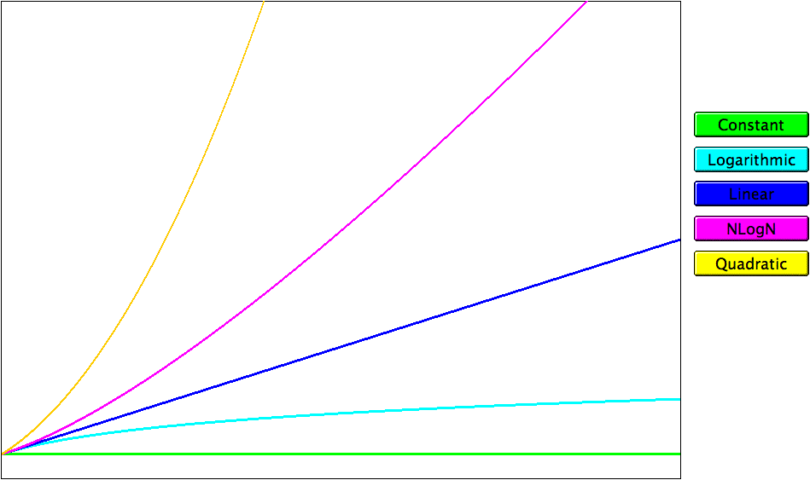
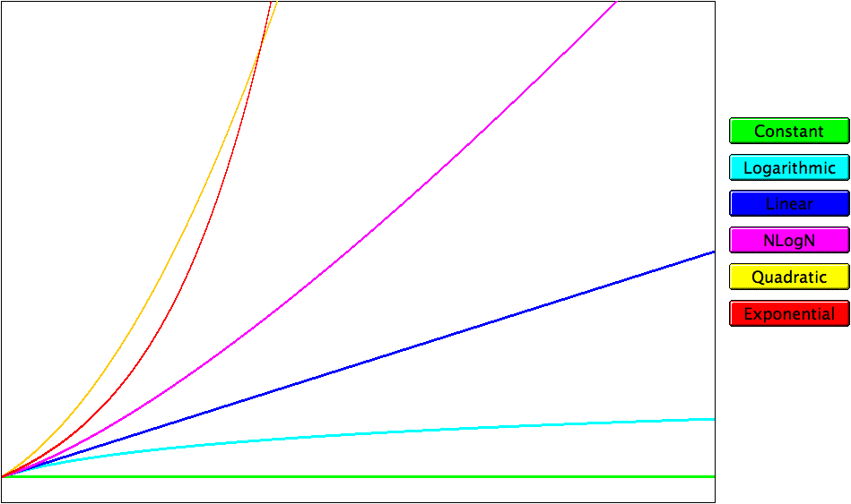
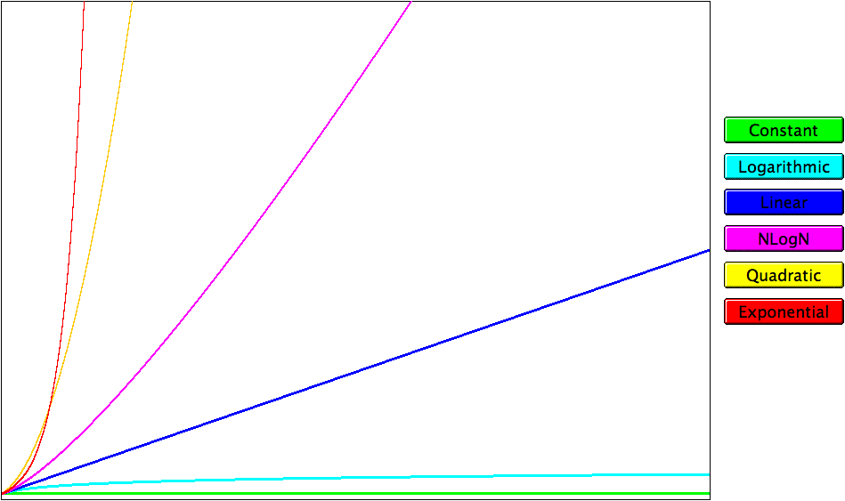
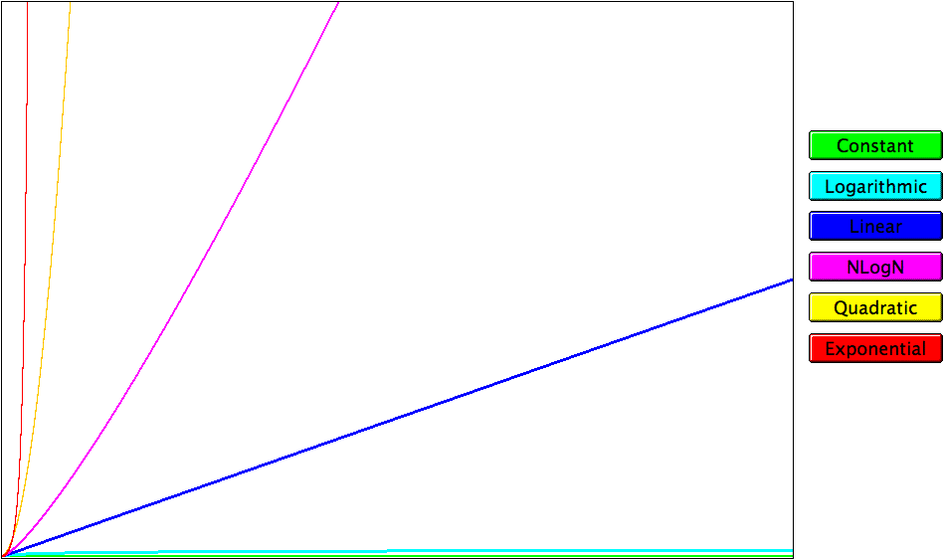
Complexity Classes
running time
problem size

Slide 39
Today’s Goals
Games
Exploration
Sorting
Big O
Searching
Big O River

Slide 40
Today’s Goals
Games
Exploration
Sorting
Big O
Searching
Big O River

Slide 41
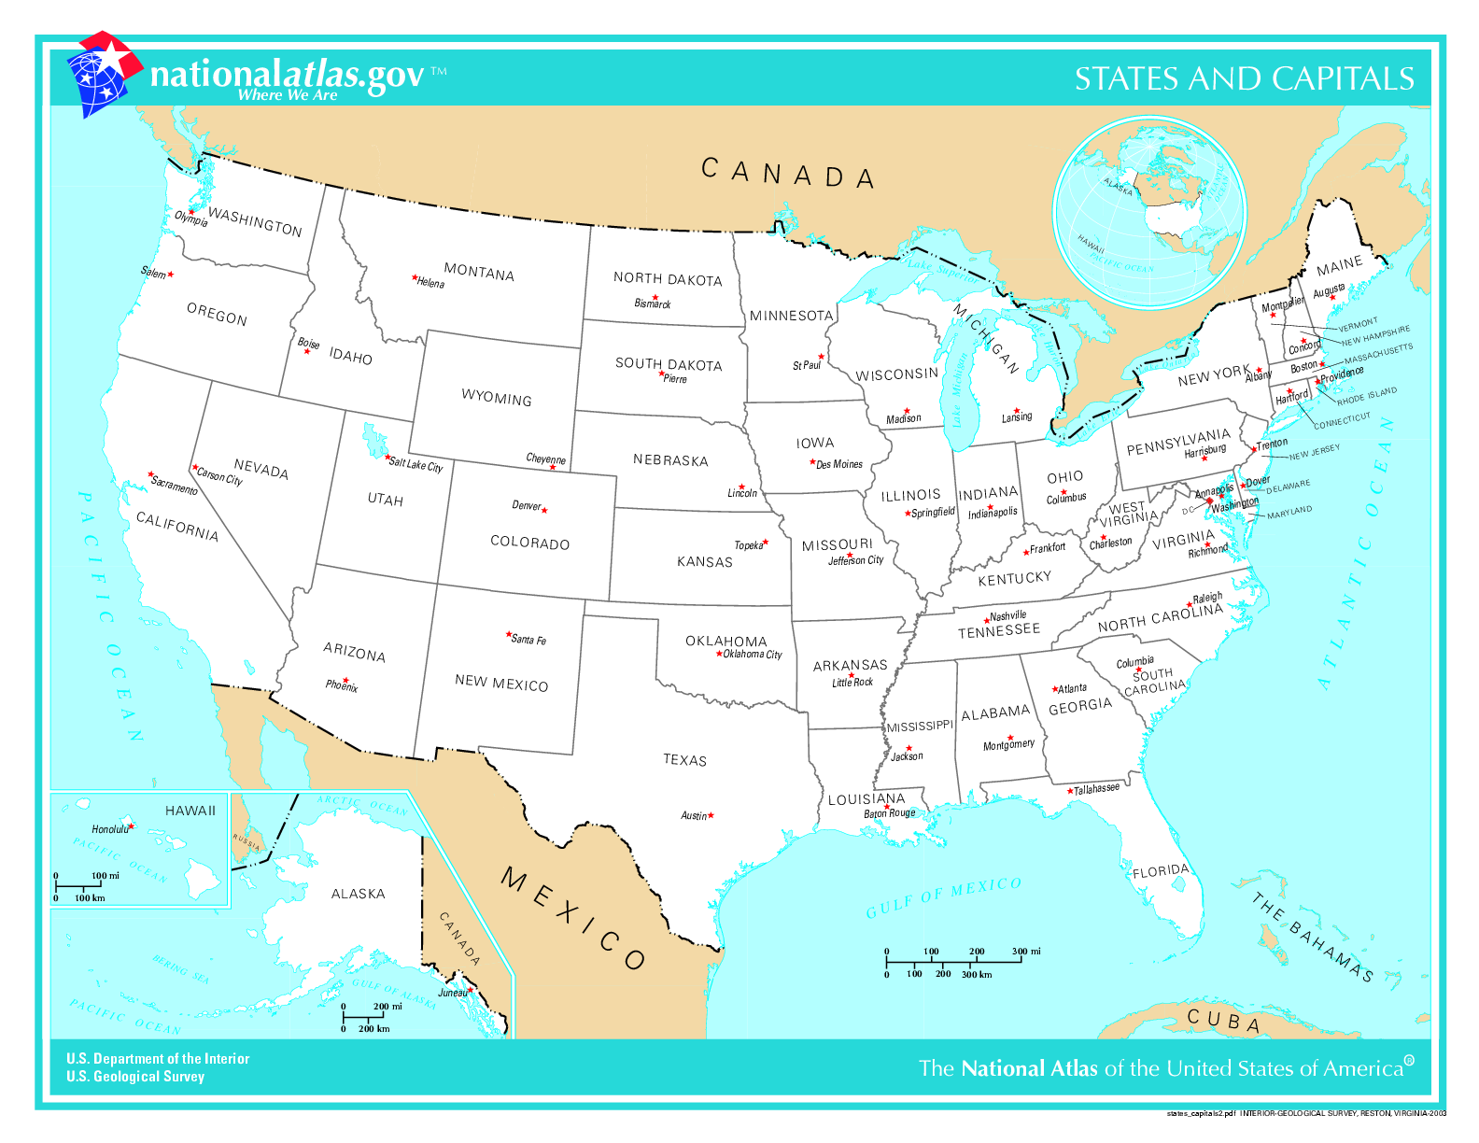
Traveling Salesperson Problem:
We have a bunch of cities to visit. In what order should we visit them to minimize total travel distance?

Slide 42
Exhaustively try all orderings: O(n!)
Potential best algorithm: O(2^{n})

Slide 43
So let’s say we come up with a way to solve Traveling Salesperson Problem in O(2^{n}).
It would take ~4 days to solve Traveling Salesperson Problem on 50 state capitals (with 3GHz computer)

Slide 44

Two Tiny Updates
Imagine we approve statehood for Puerto Rico
Add San Juan, the capital city
Also add Washington, DC
Now 52 capital cities instead of 50

Slide 45
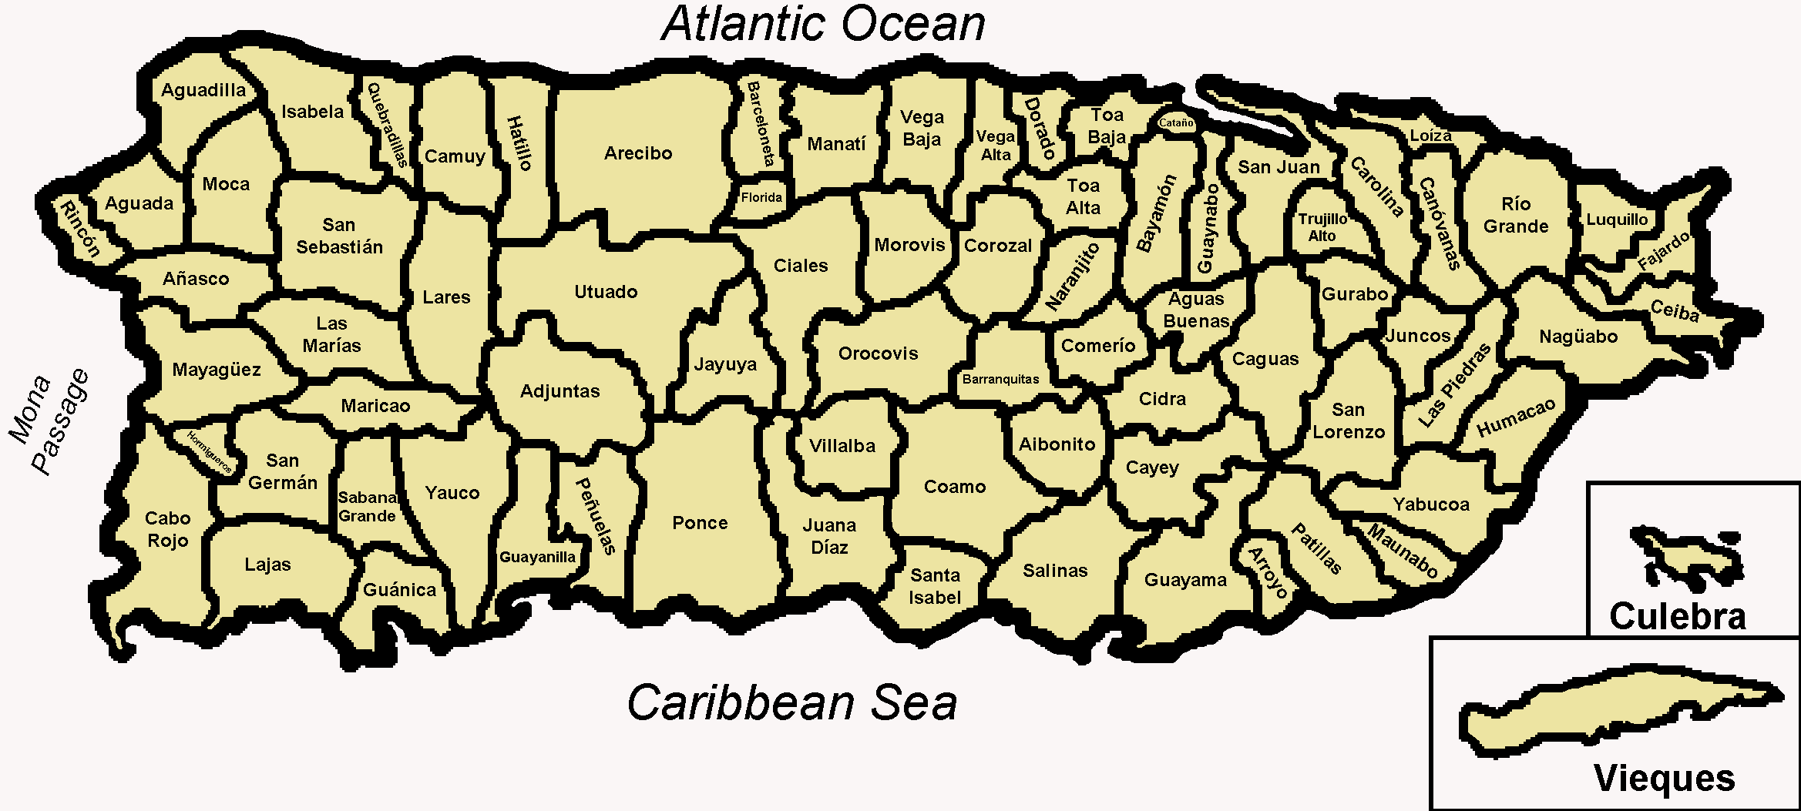
For 50 state capitals: ~4 days
With the O(2^{n}) algorithm we invented, it would take ~__?__ days to solve Traveling Salesperson problem on 50 state capitals + 2 (DC and San Juan)
6 days
8 days
10 days
> 10 days

Slide 46
With the O(2^{n}) algorithm we invented, it would take ~17 days to solve Traveling Salesperson problem on 50 state capitals + 2 (DC and San Juan)

Slide 47
Sacramento is not exactly the most interesting or important city in California (sorry, Sacramento). What if we add the 12 biggest non-capital cities in the United States to our map?

Slide 48
With the O(2^{n}) algorithm we invented,
It would take 194 YEARS to solve Traveling Salesman problem on 64 cities (state capitals + DC + San Juan + 12 biggest non-capital cities)

Slide 49
log₂n | n | n log₂n | n² | 2^{n}
2 | 4 | 8 | 16 | 16
3 | 8 | 24 | 64 | 256
4 | 16 | 64 | 256 | 65,536
5 | 32 | 160 | 1,024 | 4,294,967,296
6 | 64 | 384 | 4,096 | 1.84 x 10¹⁹
7 | 128
8 | 256
9 | 512
10 | 1,024
30 | 1,300,000,000

Slide 50
log₂n | n | n log₂n | n² | 2^{n}
2 | 4 | 8 | 16 | 16
3 | 8 | 24 | 64 | 256
4 | 16 | 64 | 256 | 65,536
5 | 32 | 160 | 1,024 | 4,294,967,296
6 | 64 | 384 | 4,096 | 1.84 x 10¹⁹
7 | 128
8 | 256
9 | 512
10 | 1,024
30 | 1,300,000,000
194 YEARS

Slide 51
log₂n | n | n log₂n | n² | 2^{n}
2 | 4 | 8 | 16 | 16
3 | 8 | 24 | 64 | 256
4 | 16 | 64 | 256 | 65,536
5 | 32 | 160 | 1,024 | 4,294,967,296
6 | 64 | 384 | 4,096 | 1.84 x 10¹⁹
7 | 128 | 896 | 16,384 | 3.40 x 10³⁸
8 | 256
9 | 512
10 | 1,024
30 | 1,300,000,000
3,590,000,000,000,000,000,000 YEARS

Slide 52
log₂n | n | n log₂n | n² | 2^{n}
2 | 4 | 8 | 16 | 16
3 | 8 | 24 | 64 | 256
4 | 16 | 64 | 256 | 65,536
5 | 32 | 160 | 1,024 | 4,294,967,296
6 | 64 | 384 | 4,096 | 1.84 x 10¹⁹
7 | 128 | 896 | 16,384 | 3.40 x 10³⁸
8 | 256 | 2,048 | 65,536 | 1.16 x 10⁷⁷
9 | 512
10 | 1,024
30 | 1,300,000,000
For comparison: there are about 10E+80 atoms in the universe. No big deal.

Slide 53
log₂n | n | n log₂n | n² | 2^{n}
2 | 4 | 8 | 16 | 16
3 | 8 | 24 | 64 | 256
4 | 16 | 64 | 256 | 65,536
5 | 32 | 160 | 1,024 | 4,294,967,296
6 | 64 | 384 | 4,096 | 1.84 x 10¹⁹
7 | 128 | 896 | 16,384 | 3.40 x 10³⁸
8 | 256 | 2,048 | 65,536 | 1.16 x 10⁷⁷
9 | 512 | 4,608 | 262,144 | 1.34 x 10¹⁵⁴
10 | 1,024
30 | 1,300,000,000
1.42E+137 YEARS (another way of thinking about the size: including commas, this number of years cannot be written in a single tweet)

Slide 54
log₂n | n | n log₂n | n² | 2^{n}
2 | 4 | 8 | 16 | 16
3 | 8 | 24 | 64 | 256
4 | 16 | 64 | 256 | 65,536
5 | 32 | 160 | 1,024 | 4,294,967,296
6 | 64 | 384 | 4,096 | 1.84 x 10¹⁹
7 | 128 | 896 | 16,384 | 3.40 x 10³⁸
8 | 256 | 2,048 | 65,536 | 1.16 x 10⁷⁷
9 | 512 | 4,608 | 262,144 | 1.34 x 10¹⁵⁴
10 | 1,024 | 10,240 (.000003s) | 1,048,576 (.0003s) | 1.80 x 10³⁰⁸
30 | 1,300,000,000 | 39000000000 (13s) | 1690000000000000000 (18 years)
LOL

Slide 55
log₂n | n | n log₂n | n² | 2^{n}
2 | 4 | 8 | 16 | 16
3 | 8 | 24 | 64 | 256
4 | 16 | 64 | 256 | 65,536
5 | 32 | 160 | 1,024 | 4,294,967,296
6 | 64 | 384 | 4,096 | 1.84 x 10¹⁹
7 | 128 | 896 | 16,384 | 3.40 x 10³⁸
8 | 256 | 2,048 | 65,536 | 1.16 x 10⁷⁷
9 | 512 | 4,608 | 262,144 | 1.34 x 10¹⁵⁴
10 | 1,024 | 10,240 (.000003s) | 1,048,576 (.0003s) | 1.80 x 10³⁰⁸
30 | 1,300,000,000 | 39000000000 (13s) | 1690000000000000000 (18 years)
2^{n} is way into crazy LOL territory, but look at nlog₂n—only 13 seconds!!
LOL

Slide 56
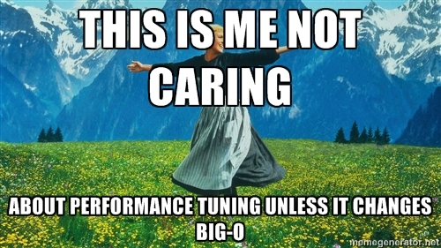

Slide 57
Today’s Goals
Games
Exploration
Sorting
Big O
Searching
Big O River

Slide 58
Today’s Goals
Games
Exploration
Sorting
Big O
Searching
Big O River

Slide 59
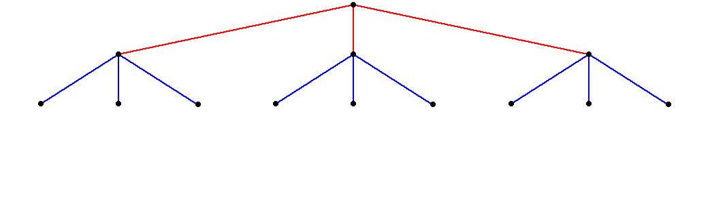
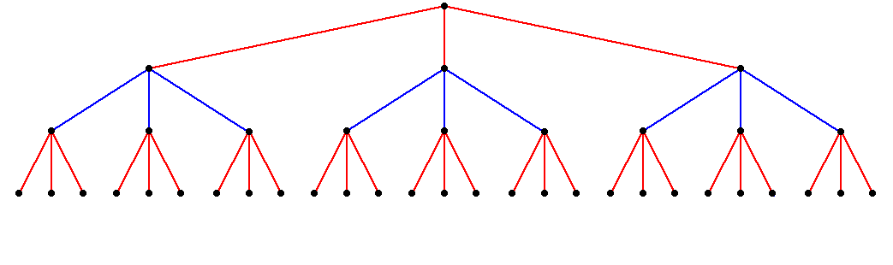
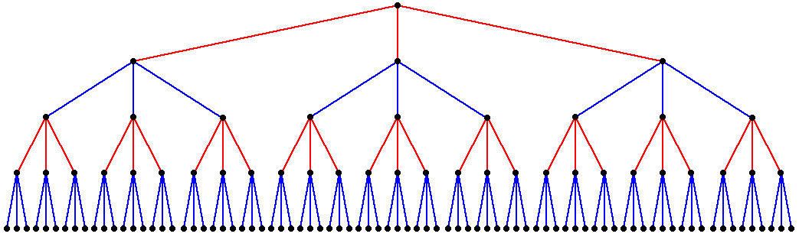
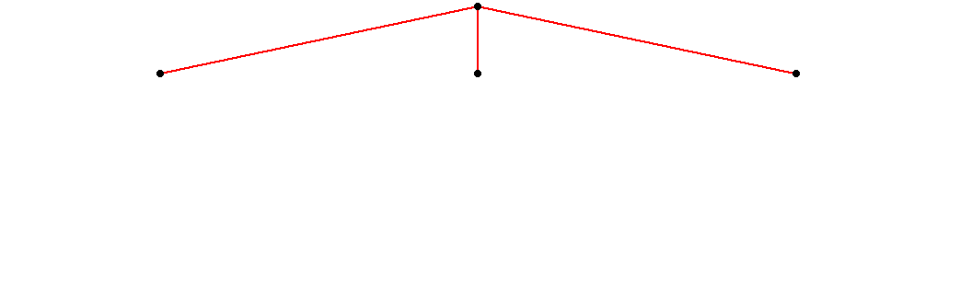
Game Trees
As Shannon observed in 1950, most two-player games have the same basic form:
The first player (red) must choose between a set of moves
For each move, the second player (blue) has several responses.
For each of these responses, red has further choices.
For each of these new responses, blue makes another decision.
And so on . . .

Slide 60
The Game of Nim
Chess is far too complex a game to serve as a useful example. The text uses a much simpler game called Nim, which is representative of a large class of two-player games.
In Nim, the game begins with a pile of coins between two players. The starting number of coins can vary and should therefore be easy to change in the program.
In alternating turns, each player takes one, two, or three coins from the pile in the center.
The player who takes the last coin loses.

Slide 61

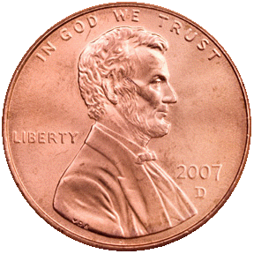
The Game of Nim
Nim
There are 11 coins left.
I'll take 2.
There are 9 coins left.
Your move:
1
There are 8 coins left.
I'll take 3.
There are 5 coins left.
Your move:
2
There are 3 coins left.
I'll take 2.
There is only one coin left.
You lose.

Slide 62
Minimax Illustration
Suppose that the ratings two turns from now are as shown.
From your perspective, the +9 initially looks attractive.
Unfortunately, your can’t get there, since the –5 is better for your opponent.
The best you can do is choose the move that leads to the –2.
+7
+6
–9
–5
+9
–4
–1
+1
–2

Slide 64
Go Complexity
Complexity
When n=19

Slide 65
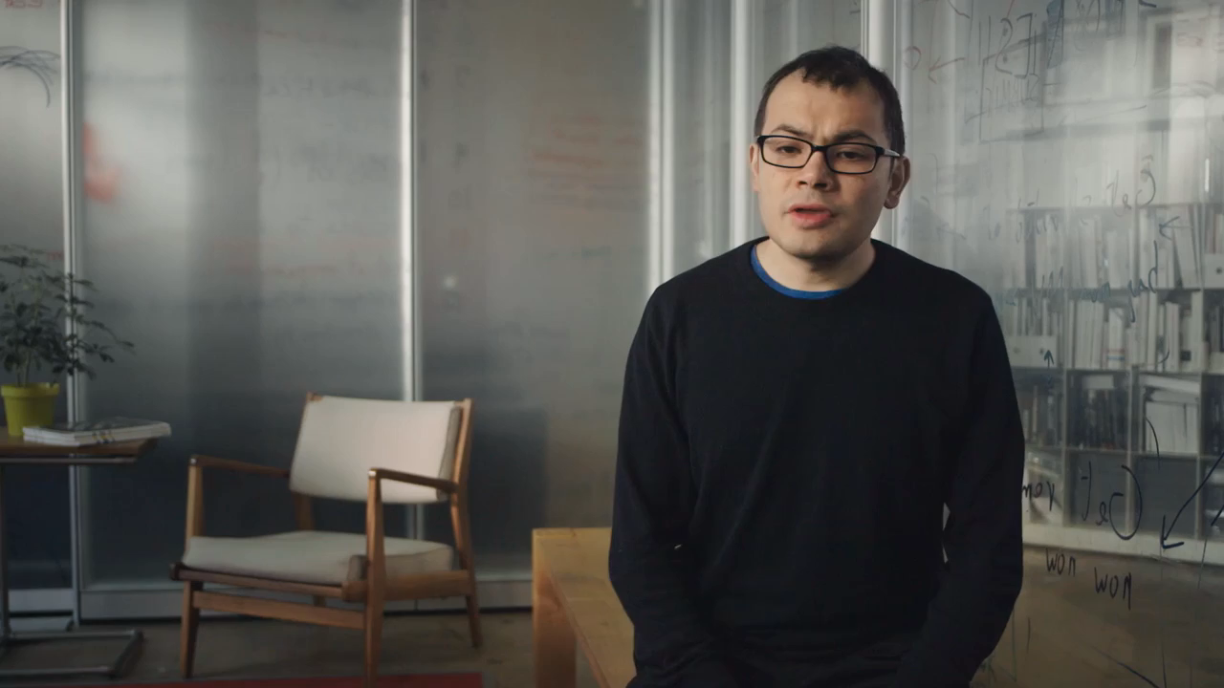

Slide 66
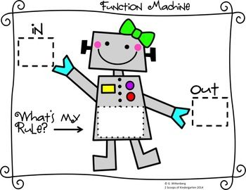
Remember This?
1
2
1
3
6
0.99
-2
0
1
1
InputSum = input1 * weight1 +
input2 * weight2 +
input3 * weight3 +
input4 * weight4;
Output = sigmoid(InputSum);
You don’t know what automata is, do you? SOON!
double neuron(double x1, double x2);

Slide 67
Today’s Goals
Understand Big O

